Slide 1
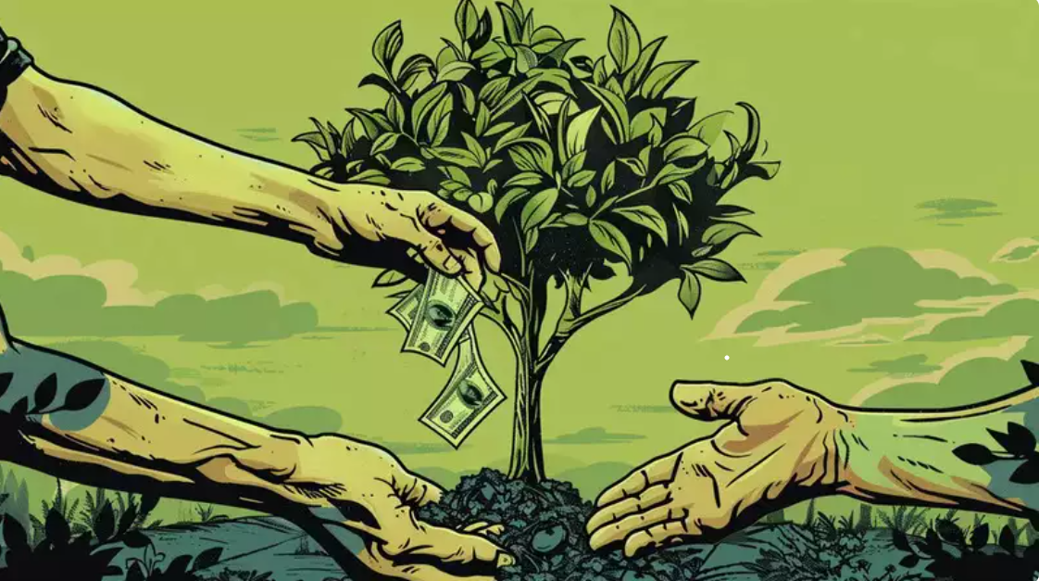
GREEN CREDIT MANAGEMENT
MANAGING YOUR FINANCIAL FUTURE
Teamname - Supersquad

Slide 2
Problem Statement
The green credit market faces significant challenges, including a lack of transparency,
high transaction costs, and limited accessibility. These issues hinder the efficient trading and verification of green credits. Our Ethereum-based marketplace seeks to solve these problems by offering a transparent, cost-effective, and easily accessible platform for buying, selling, and redeeming green credits.

Slide 3
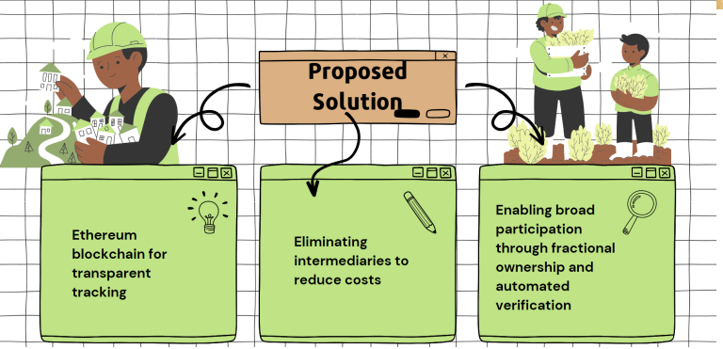

SOLUTION
Our Green Credit market is based on the ERC20 Ethereum standard. By moving this to the blockchain, we eliminate the margins lost to liquidity providers, allow for better transparency and increase participation in our Ethereum-based market and awareness of the green agenda.

Slide 4



Approach
PROJECT DEVELOPERS:
REGISTER THEIR DETAILS AND GET GREEN CREDIT ACCORDINGLY
Include farmers, agricultural businesses, rural communities, governmental bodies, NGOs, and private sector companies.
OUR PLATFORM:
-> CREATE SMART CONTRACTS
->ISSUES THE GREEN CREDITS
->TRADING OF GREEN CREDITS
CORPORATIONS:
BUY GREEN CREDITS LISTED
IN OUR PLATFORM
Companies that cannot meet these targets through direct emission reductions can purchase green credits to offset their excess emissions.

Slide 5
Green Credit Issuance
Listing
Smart Contracts: Our platform creates smart contracts on Ethereum to define terms for issuing green credits.
Project Registration: Developers register projects, detailing environmental benefits and methodologies.
Tokenization: Approved projects have their green credits tokenized into ERC-20 or ERC-721 tokens, representing carbon offsets.
Verification
Third-Party Auditors: Independent auditors verify projects based on set standards
.
On-Chain Verification: Results are recorded on the blockchain for transparency.
Smart Contract Updates: Verified projects are updated to issue green credit tokens.

Slide 6
Green Credit TRADEREMPTION
Trading
Platform: Use our online marketplace.
Pricing: Real-time market-based pricing.
Matching: Connect buyers and sellers.
Security: Ensure safe transactions.
Dynamics: Market forces drive credit value.
Redemption
Offset: Use credits to offset emissions.
Compliance: Meet regulatory requirements.
CSR: Enhance corporate sustainability reporting.
Recognition: Gain public recognition.
Incentives: Receive government benefits.

Slide 7
TECH STACK
Solidity
React
Redux
Tailwind
NodeJS
Metamask

Slide 8
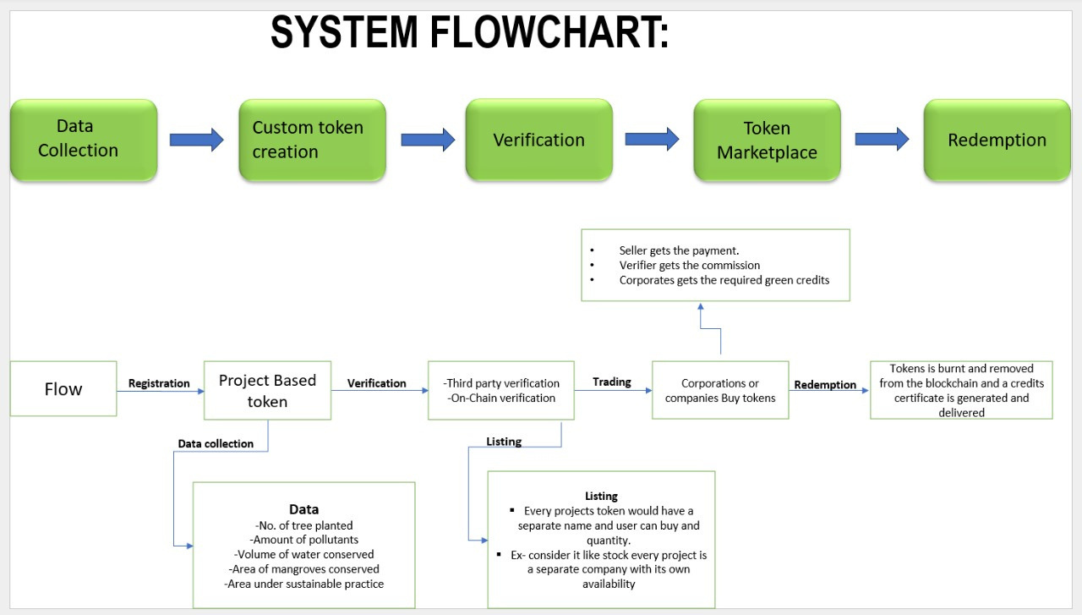

Slide 9
WHY CHOOSE US
PREVENTING GREEN WASHING :
Immutable Records with Ethereum Blockchain
Use Ethereum blockchain for secure, tamper-proof records.
Ensures transparency and traceability of all credits.
Third-Party Verification:
Accredited verifiers conduct rigorous audits.
Adds credibility and trust to the credits.
Regular Audits:
Conduct regular and random checks for compliance.
Detects and addresses fraudulent activities.

Slide 10
User Experience Friendly
Intuitive Interface
User-friendly design for easy navigation and access to features.
Simple and clear processes for registering and managing projects.
Verification and Validation
Transparency Portal:
Make all verification and validation reports publicly available on the website.
Government agencies can access and review immutable transaction histories, ensuring data integrity.
Increased Scope for Small Projects
Open to small-scale projects and individual initiatives.
Provides equal opportunities for all participants.
Step-by-step assistance to help small projects get started.

Slide 11

FUTURE SCOPE
Transitioning to Hedera for Lower Transaction Fees
Lower Costs: Affordable transaction fees.
Increased Speed: Faster transaction times
.
Security and Reliability: Robust and secure network.
Sustainability: Energy-efficient and environmentally friendly.
User-Friendly: Cost-effective and efficient for users.

Slide 12
Addressing Regional Differences with API Location Fetch
Tailored Reporting:
Regional Insights: Provide detailed reports with insights specific to each region.
Stakeholder Engagement: Engage local stakeholders with relevant and actionable data.
Adding a Carbon Credit Market
Unified Marketplace: Create a single marketplace for trading both green and carbon credits.
Efficient Transactions: Streamline the process of buying, selling, and redeeming credits.

Slide 13
"Sustainable practices lead to financial success and a healthier planet for all."
THANKS
TEAM -SUPERSQUAD

